Slide 1
Project 1
Making of a Simple calculator using python GUI

Slide 2
Code to run
from tkinter import *
def buttonClick(number):
global operator
operator = operator + str(number)
input_value.set(operator)
def buttonClear():
global operator
operator =""
input_value.set("")
def buttonEqual():
global operator
result = str(eval(operator))
input_value.set(result)
operator =""
main = Tk()

Slide 3
main.title("Calculator")
operator = ""
input_value = StringVar()
display_text = Entry(main, font=("arial,20,""bold"),textvariable=input_value,bd=30,insertwidth=4,
bg="light green", justify=RIGHT)
display_text.grid(columnspan=4)
# Row 1 7 8 9 +
btn_7 = Button(main,padx=16,bd=8,fg="black",font=("arial",20,"bold"),text="7",command=lambda:buttonClick(7))
btn_7.grid(row=1,column=0)
btn_8 = Button(main,padx=16,bd=8,fg="black",font=("arial",20,"bold"),text="8",command=lambda:buttonClick(8))
btn_8.grid(row=1,column=1)
btn_9 = Button(main,padx=16,bd=8,fg="black",font=("arial",20,"bold"),text="9",command=lambda:buttonClick(9))
btn_9.grid(row=1,column=2)
btn_add = Button(main,padx=16,bd=8,fg="black",font=("arial",20,"bold"),text="+",command=lambda:buttonClick("+"))
btn_add.grid(row=1,column=3)
# Row 2 4 5 6 -
btn_4 = Button(main,padx=16,bd=8,fg="black",font=("arial",20,"bold"),text="4",command=lambda:buttonClick(4))
btn_4.grid(row=2,column=0)
btn_5 = Button(main,padx=16,bd=8,fg="black",font=("arial",20,"bold"),text="5",command=lambda:buttonClick(5))
btn_5.grid(row=2,column=1)
btn_6 = Button(main,padx=16,bd=8,fg="black",font=("arial",20,"bold"),text="6",command=lambda:buttonClick(6))
btn_6.grid(row=2,column=2)
btn_sub = Button(main,padx=16,bd=8,fg="black",font=("arial",20,"bold"),text="-",command=lambda:buttonClick("-"))
btn_sub.grid(row=2,column=3)
# Row 3 1 2 3 *
btn_1 = Button(main,padx=16,bd=8,fg="black",font=("arial",20,"bold"),text="1",command=lambda:buttonClick(1))
btn_1.grid(row=3,column=0)
btn_2 = Button(main,padx=16,bd=8,fg="black",font=("arial",20,"bold"),text="2",command=lambda:buttonClick(2))
btn_2.grid(row=3,column=1)
btn_3 = Button(main,padx=16,bd=8,fg="black",font=("arial",20,"bold"),text="3",command=lambda:buttonClick(3))
btn_3.grid(row=3,column=2)
btn_mul = Button(main,padx=16,bd=8,fg="black",font=("arial",20,"bold"),text="*",command=lambda:buttonClick("*"))
btn_mul.grid(row=3,column=3)
# Row 4 0 c = /
btn_0 = Button(main,padx=16,bd=8,fg="black",font=("arial",20,"bold"),text="0",command=lambda:buttonClick(0))
btn_0.grid(row=4,column=0)
btn_clear = Button(main,padx=16,bd=8,fg="black",font=("arial",20,"bold"),text="c",command=buttonClear)
btn_clear.grid(row=4,column=1)
btn_equal = Button(main,padx=16,bd=8,fg="black",font=("arial",20,"bold"),text="=",command=buttonEqual)
btn_equal.grid(row=4,column=2)
btn_div = Button(main,padx=16,bd=8,fg="black",font=("arial",20,"bold"),text="/",command=lambda:buttonClick("/"))
btn_div.grid(row=4,column=3)
main.mainloop()

Slide 4
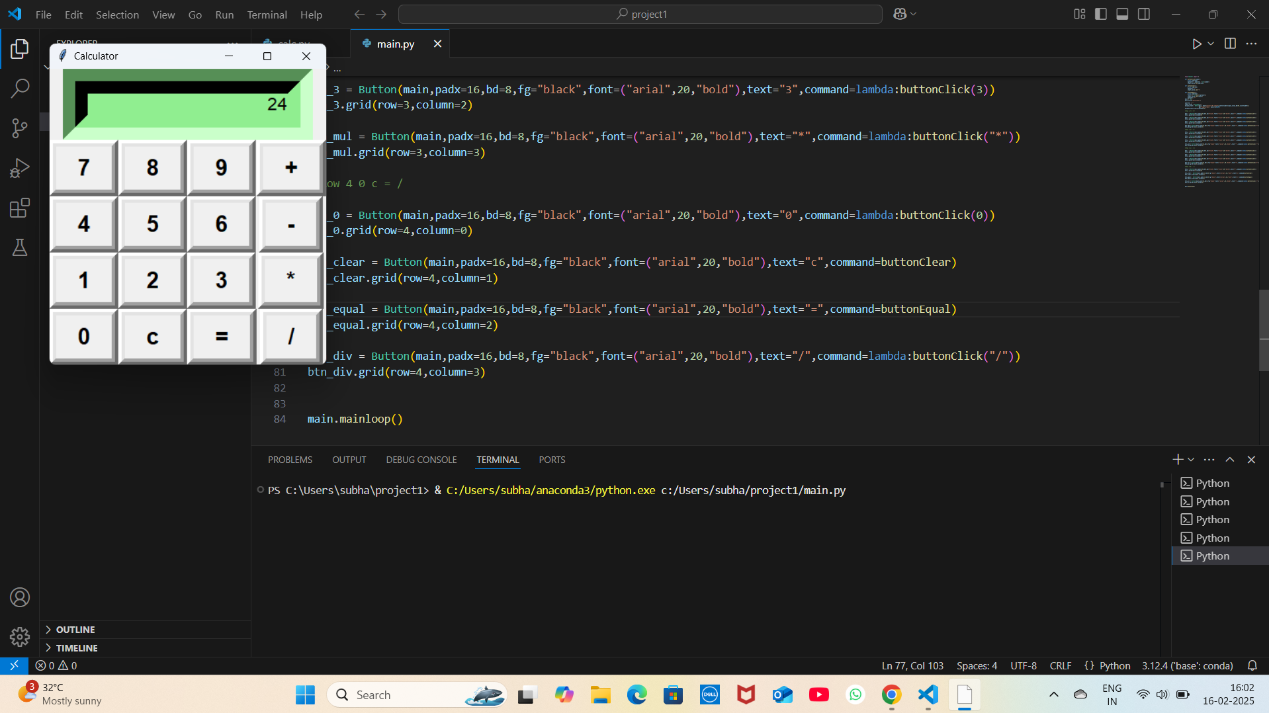

Slide 5
Thank You

